Slide 1
BUILDER PATTERN
A patterns-box talk
by
Jose Palacios

Slide 2
About me
Hi, I’m Jose, Software Engineer 3 at Belatrix. Currently I’m working at La Familia Team on the convertion modules

Slide 3
01
02
03
04
Goal
Real world case
Architecture
Problems it solves

Slide 4
05
06
07
08
When to use it?
When not to use it?
Common mistakes
Advantages

Slide 5
Goal
Separate the construction of a complex object from its representation so that the same construction process can create different representations

Slide 6
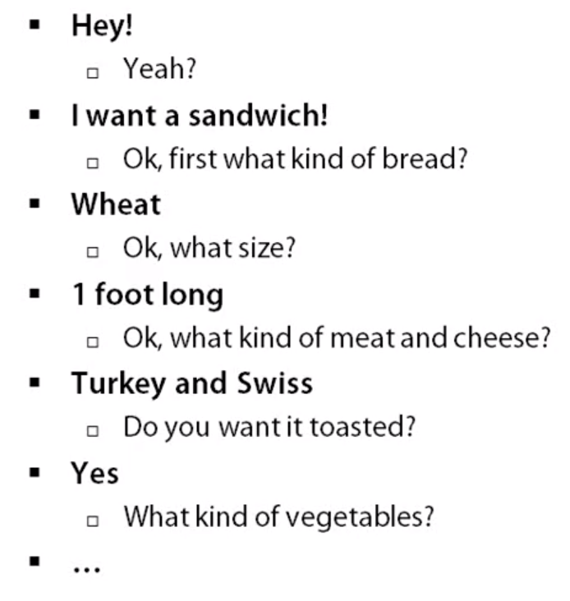
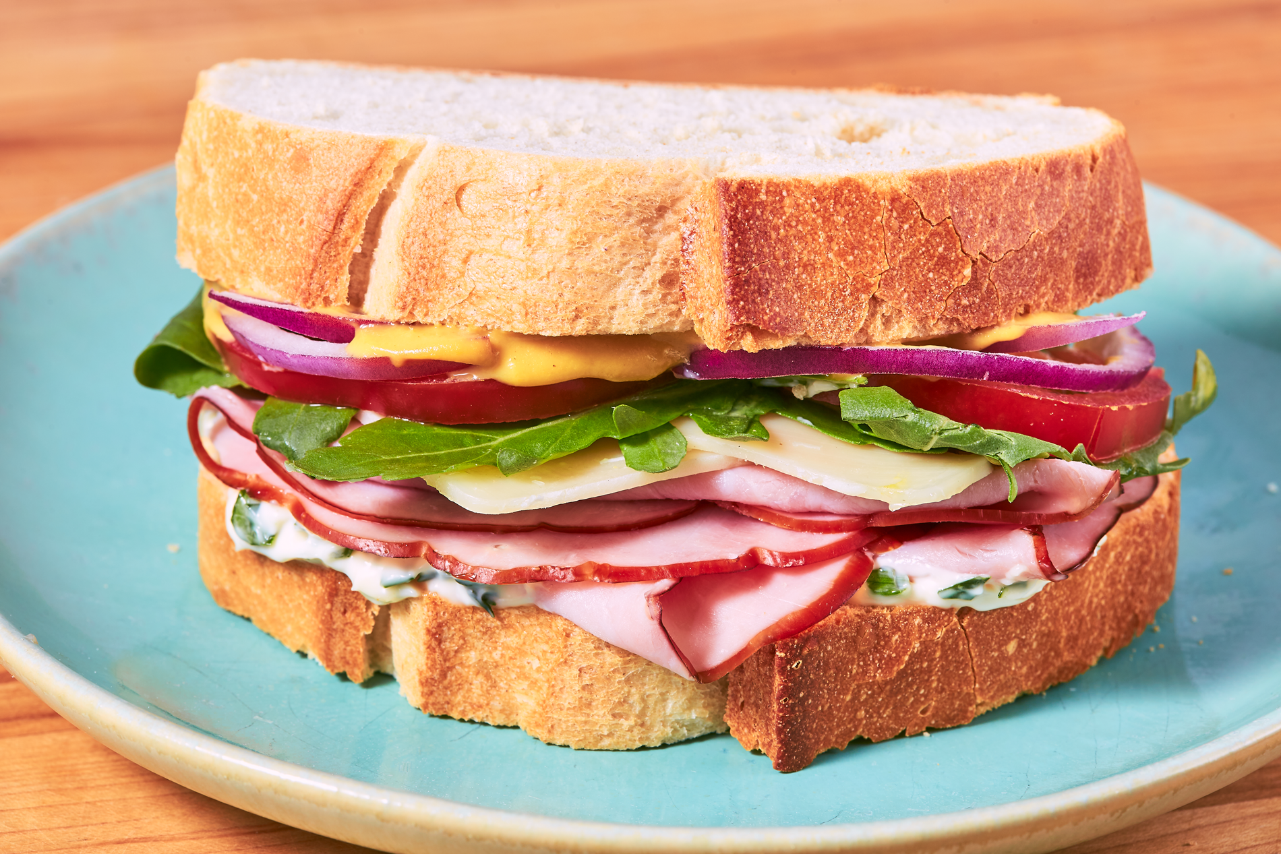
Real world case

Slide 7
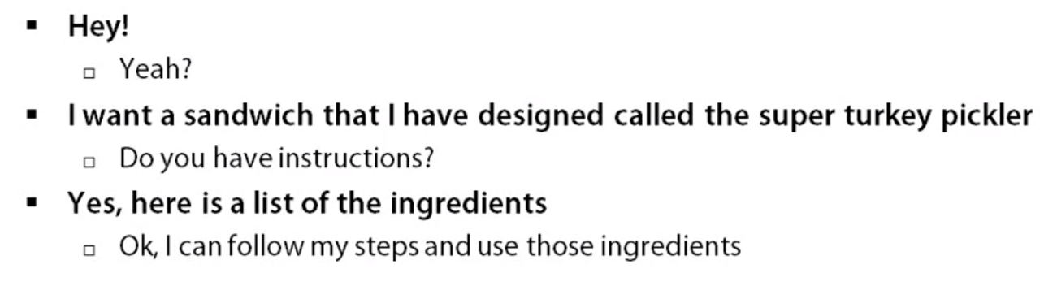
Real world case

Slide 8
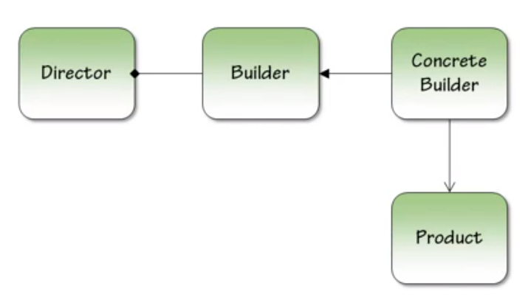
Architecture

Slide 9

Problems it solves
Too many parameters
Order dependent
Different constructions

Slide 10

When to use it?
Telescoping constructors
When you need different representations of the same object

Slide 11

When not to use it?
When you don’t need different configurations of the same object

Slide 12

Common mistakes
Forcing the pattern

Slide 13

Advantages
Single Responsibility Principle.
Open/Closed Principle.
Scalability
Testability

Slide 14
Demo

Slide 15

Thanks

